Slide 1
Using Python
Chapter 1 – Part 2

Slide 2
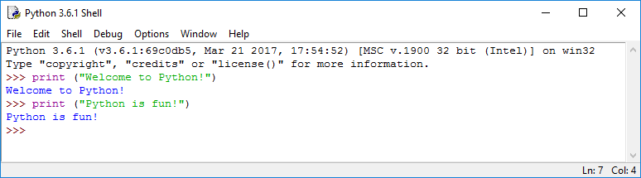
Launch Python IDLE

Slide 3
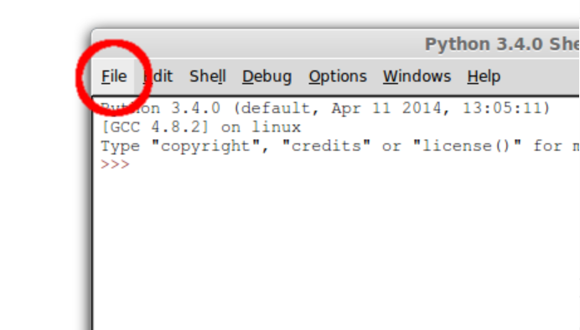
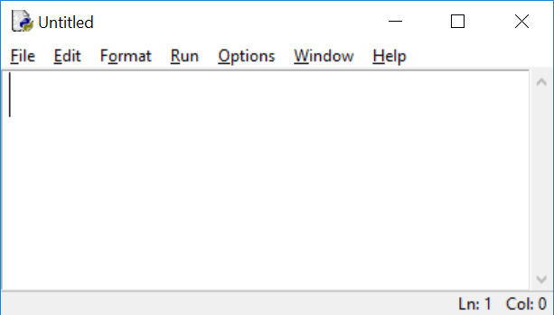
The File Menu
Under File, select New File or press Ctrl + N. That will bring up a new window titled, “Untitled”.

Slide 4
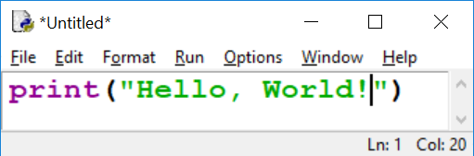
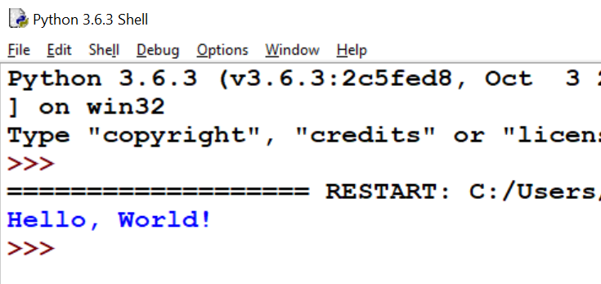
Writing, Saving and Running Python Programs with IDLE
Enter this command in the Untitled window:
2. Save the file before you can run it. So under File, select Save. Name it: Hello.py.
3. Under Run, select Run Module.
4. Now go back to the Shell.
The shell is restarted every time you run a
module in IDLE. That’s to clear out any old
settings that might interfere with your
program.

Slide 5

A Simple Python Program

Slide 6
Anatomy of a Python Program
Statements
Comments
Indentation

Slide 7
Statements
A statement represents an action or a sequence of actions.
The statement print (“Welcome to Python”) in the program is a statement to display the greeting “Welcome to Python”.

Slide 8
Comment
In the Welcome program, line 1 is a comment that documents what the program is and how it is constructed. Comments help programmers communicate and understand a program. They are not programming statements and thus are ignored by the interpreter.
In Python, comments are preceded by a pound sign (#) on a line, called a line comment, or enclosed between three consecutive single quotation marks (‘ ‘ ‘) on one or several lines, called a paragraph comment.

Slide 9

Indentation
The indentation matters in Python.
Note that the statements are entered from the first column in the new line. It would cause an error if the program is typed as follows:
Error !!

Slide 10
Code Blocks and Indentation
One of the most distinctive features of Python is its use of indentation to mark block of code.
Block 1
Block 2
Block 3
Block 2, continuation
Block 1, continuation

Slide 11
Special Characters
Character | Name | Description
( ) | Opening and closing parentheses | Used with functions.
# | Pound sign | Precedes a comment line
“ ” | Opening and closing quotation marks | Encloses a string (i.e., sequence of characters).
‘ ‘ ‘ ‘ ‘ ‘ | Paragraph comments | Encloses a paragraph comment.

Slide 12
Python is Case Sensitive
Python programs are case sensitive. It means that the interpreter will consider upper case and lower case to be different characters.
It would be wrong, for example, to replace print in the program with Print.

Slide 13
Output Statements
A print statement can print any number of expressions.
Successive print statements will display on separate lines.
A bare print will print a blank line.

Slide 14
Using Python to Perform Mathematical Computation
Python programs can perform all sorts of mathematical computations and display the result.
Statement | Output | Explanation
print (3+4) | 7 | Addition: 3 + 4 = 7
print (7-2) | 5 | Subtraction: 7-2 = 5
print (3*4) | 12 | Multiplication: 3*4 = 12
print (12/5) | 2.4 | Division: 12/5 = 2.4
print (3.5 /(2 -3)) | -3.5 | 3.5/(2-3) = 3.5/(-1) = -3.5

Slide 15
Key Words, Operators, and Syntax
Key words: predefined words used to write program in high-level language, each key word has specific meaning.
Operators: perform operation on data
Example: math operators to perform arithmetic
Syntax: set of rules to be followed when writing program
Statement: individual instruction used in high-level language

